Slide 1

INKLINK
A MODERN BLOGGING PLATFORM
Presented By: Ojas Deshmukh(28), D.Yash kumar(11), Chandresh Soni(10), Dushyant Kumar(14)
Guided By: Kailash kumar patel
Department:-Computer Science Engineering

Slide 2
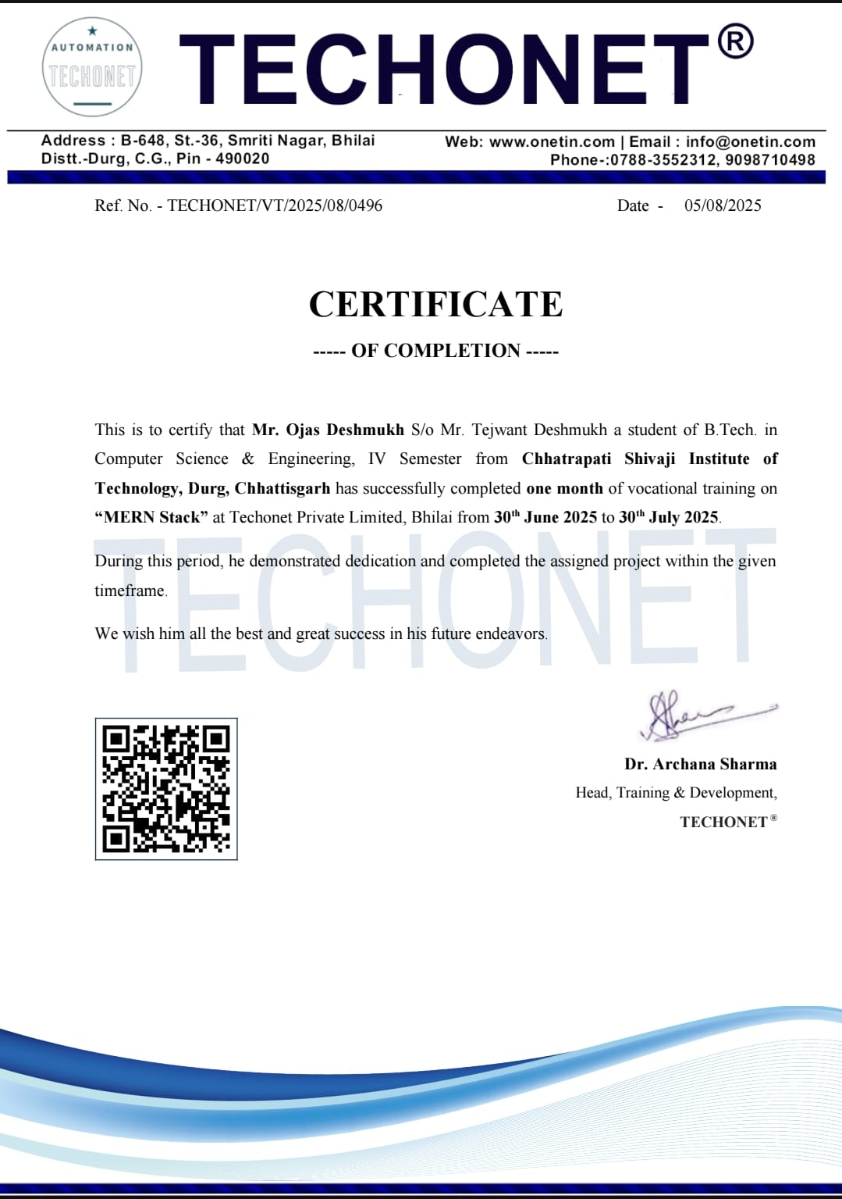
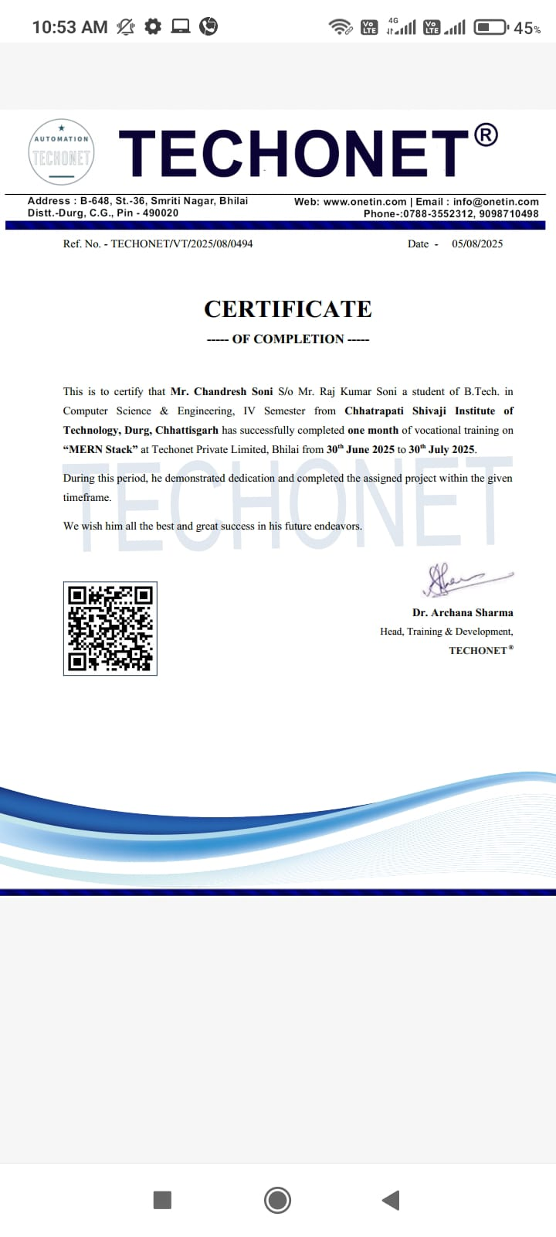
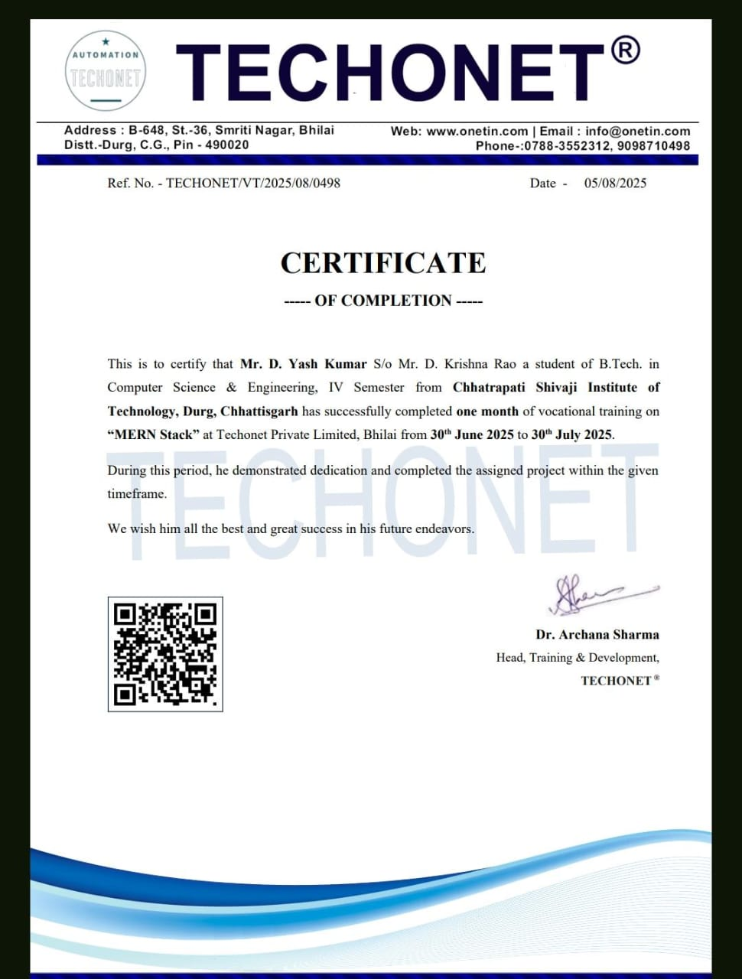
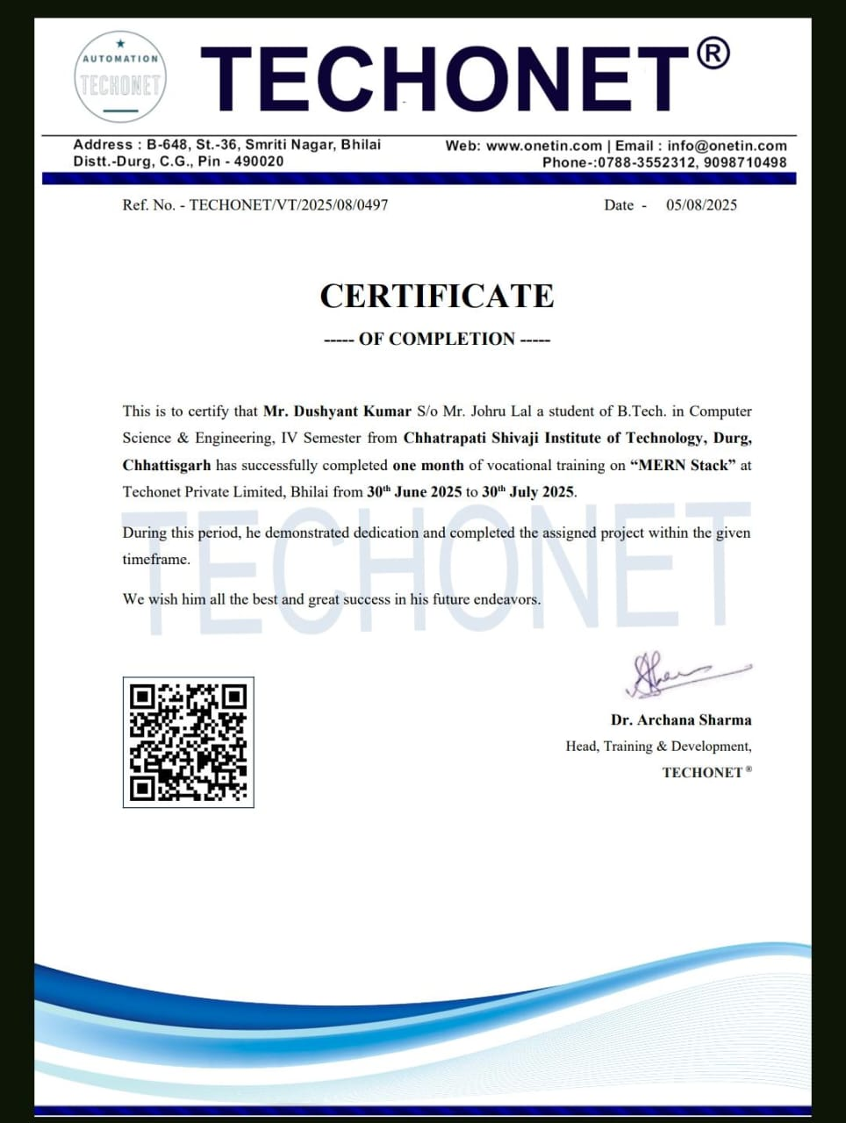
VOCATIONAL TRAINING CERTIFICATES

Slide 3
INTRODUCTION
InkLink is a personal blogging platform – a modern, visually appealing website where users can explore and read blogs across various categories. It's designed using TailwindCSS with a clean layout and responsive interface.
The goal of InkLink is to showcase trending and creative blogs in a stylish, minimal, and user-friendly way.
Purpose of inklink:
To build a community of writers and readers.
To make blogging simple, interactive, and accessible to everyone.
To give creators a platform where their ideas can reach a wider audience

Slide 4
Training Objectives
Showcase Creative Content: The primary objective of InkLink is to provide a platform for showcasing trending and creative blogs.
Create a User-Friendly Experience: The design emphasizes a clean layout and responsive interface.
Facilitate Connection: InkLink is designed to be a place where users can express their thoughts and connect with others who share similar interests.

Slide 5
TECHSTACK AND TOOLS
Frontend Tech: Tailwindcss, Vanilla JavaScript for modals, Next.js
Design Features: Responsive layout, grid system, hover/modals
Backend Tech: Node.js, Express.js
Deployment Platform: Versal—automatic Git ↔ deployment, Render
API Testing: POSTMAN

Slide 6
Key Learning
Responsive Design: Implemented a responsive layout and grid system to ensure the site works on any device
Backend and Database Integration: Learned to use Node.js and Express.js for the backend and connected it to a MongoDB database.
Secure Credential Management: Used a .env file to securely store sensitive information like API keys and database URLs.
User Authentication: Set up user authentication, including JWT , to personalize user experiences.

Slide 7
Methodology/Approach1
Frontend development:
The frontend was built using Next.js.
TailwindCSS was used to design a clean and responsive layout with a grid system.
Vanilla JavaScript was used for interactive elements like modals.
The site features a responsive design, which makes it mobile-friendly and accessible on any device.

Slide 8
Methodology/Approach2
Backend and Database:
The backend server was created using Node.js and Express.js
The server runs on Port 5000(in local) and is deployed on Render.
A MongoDB database was used to store all the dynamic content, including user and blog post data.
The frontend connects to the backend using the fetch() method.

Slide 9
Project Objectives
Core features:
Landing Page: A welcoming page that includes a header, a hero section, and a display of trending and latest blogs.
Trending Blogs Section: Displays blog posts with images, titles, and a short description, and allows users to view the full content in a modal view.
User Engagement: Encourages users to "Join InkLink" by highlighting the benefits of expressing themselves freely, connecting with other readers, and accessing a personalized dashboard.
User Communication: A dedicated contact page allows users to send feedback, report issues, or make other inquiries.

Slide 10
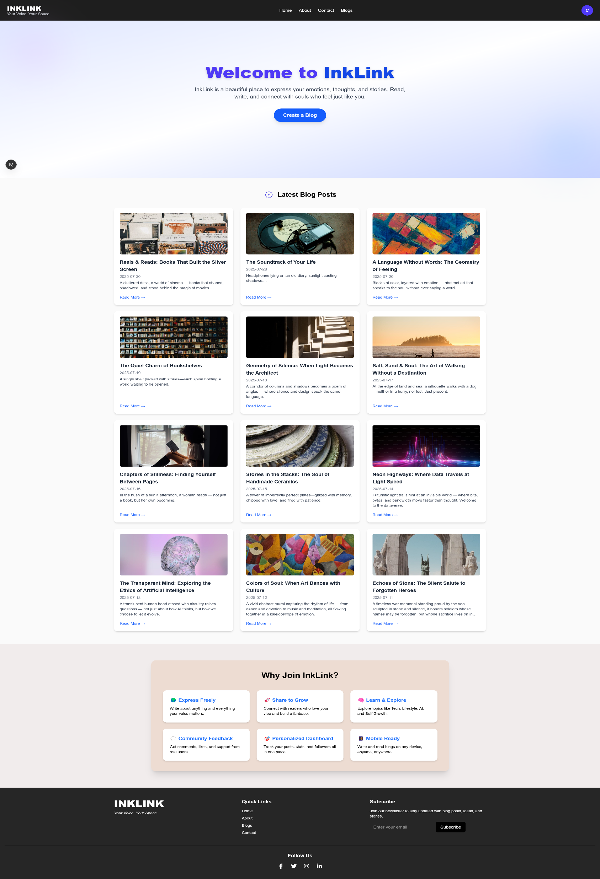
LANDING PAGE
Overview:
Modern and minimal landing page for InkLink.
Welcomes users with a clear call-to-action (“Create a Blog”).
Highlights latest blog posts in a clean grid layout.
Section for Why Join InkLink? showing key benefits.
Fully responsive design with smooth navigation (Home, About, Contact, Blog).
Key Features on Landing Page:
✨ Hero section with welcome message.
📰 “Latest Blog Posts” grid for trending content.
🎯 “Why Join InkLink?” section to attract new users.
📌 Footer with quick links, newsletter subscription, and social media.

Slide 11
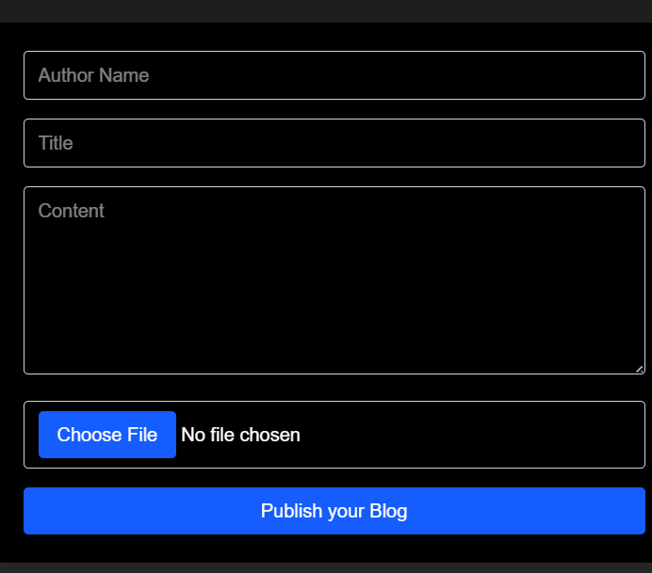
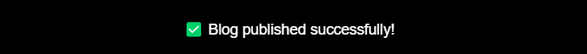
BLOG PUBLISH PAGE
Overview:
Dedicated page for users to create and publish their blogs.
Simple and minimal form design for smooth user experience.
Form Features:
✍ Author Name – identify the blog writer.
📝 Title – headline of the blog.
📖 Content – main blog text area for writing.
📂 File Upload – option to add images/files to the blog.
🚀 Publish Button – instantly post the blog to the website.
Purpose:
Enables content creators to easily share their thoughts and stories.
Makes the blogging process quick, structured, and user-friendly.

Slide 12
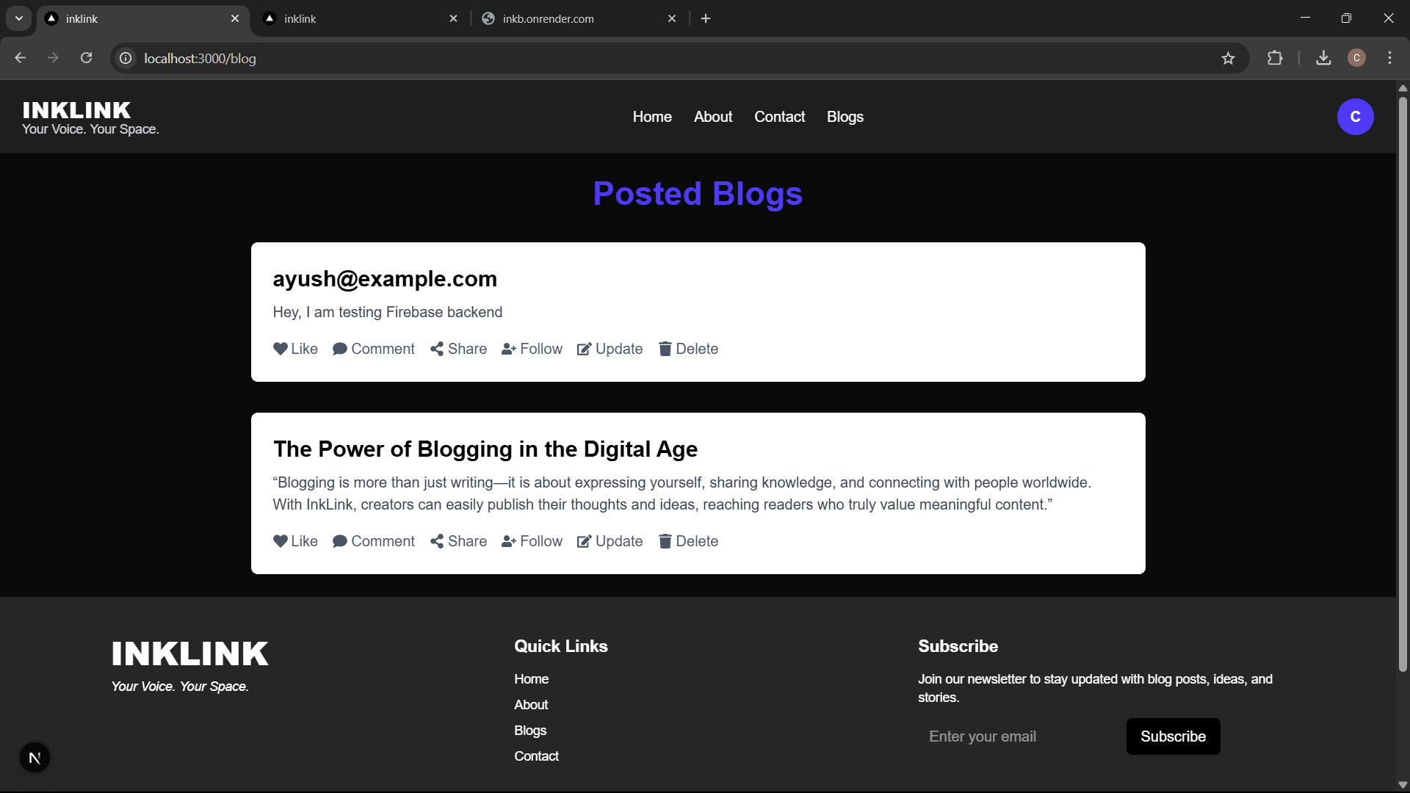
GET YOUR POSTED BLOGS
Overview:
The Posted Blogs Page displays all blogs created by users in a clean and structured format.
It allows interaction and engagement with each blog post.
Key Features:
📝 Displays Title and Content of the blog.
👍 Users can Like and Comment on blogs.
🔗 Options to Share and Follow authors.
✏ Update or 🗑 Delete for blog management.
Purpose:
Provides a space where published blogs are visible to all.
Encourages interaction through likes, comments, and shares.
Gives authors control to update or remove their content anytime.

Slide 13
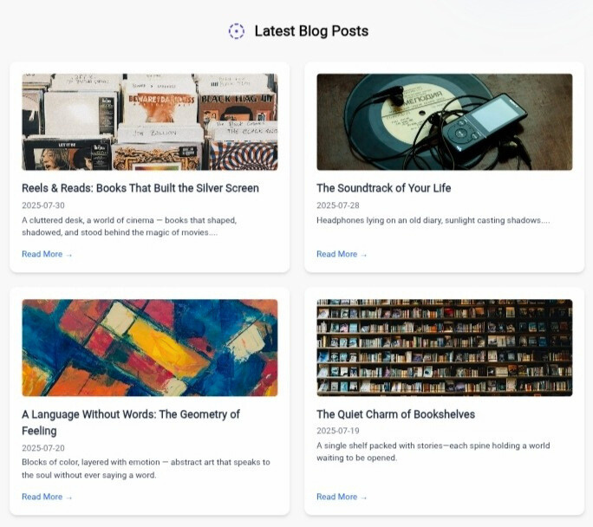
Trending Blogs (with model)
Blogs Posts with image, title, short description, read more
Onclick in read more : Model open with full blood description

Slide 14
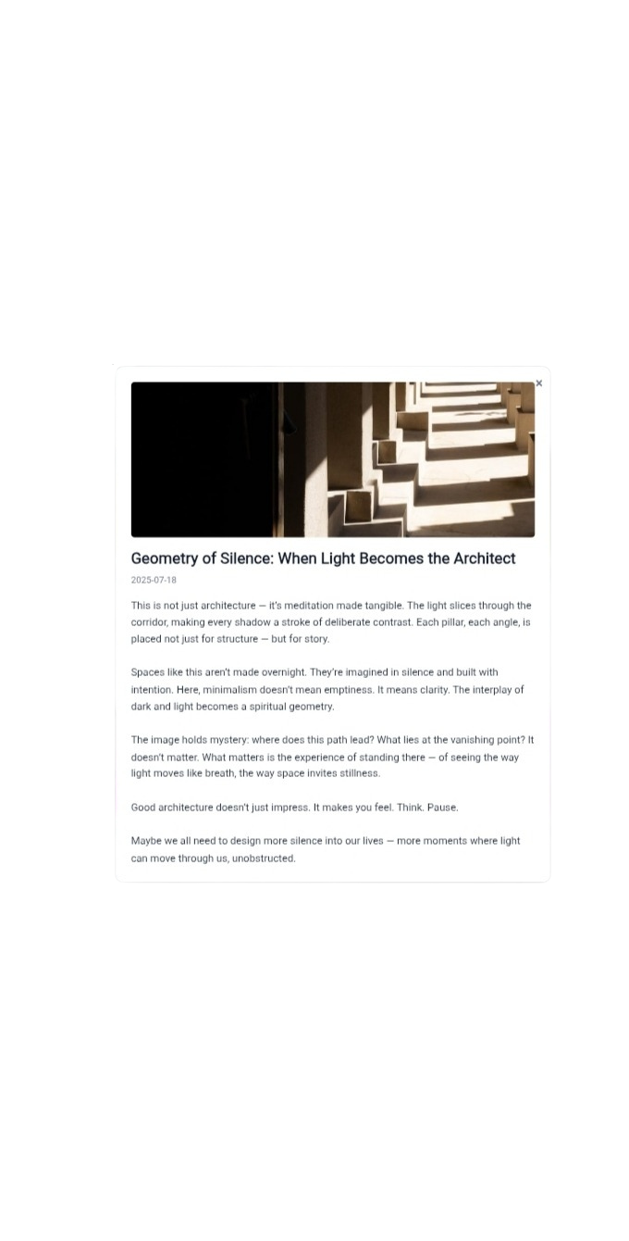
Model Implementation
Pop-out Blog View:
Display full Blog description.
Closes on overlay click or close button.

Slide 15
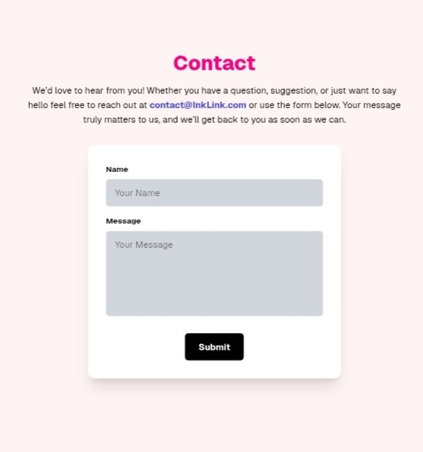
Contact Page
Purpose (Why this page exists):
To allow users to get in touch with the InkLink team.
For feedback, suggestions, partnership inquiries, or reporting issues.
Builds trust and encourages communication.

Slide 16
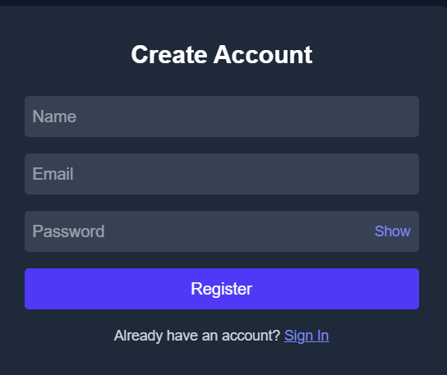
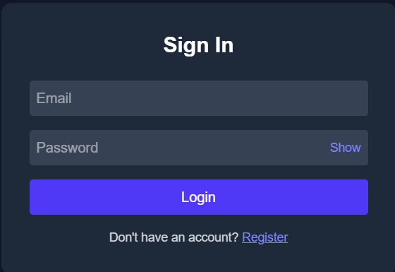
User Authentication (Login / Sign-Up)
Register Page (Create Account)
This page is designed for new users to create their accounts by entering Name, Email, and Password.
It is connected with basic email verification system for secure account creation.
Once registered, a unique user ID is generated and stored securely in MongoDB
After creating an account, users can write, publish, and manage their blogs.
2. Login Page (Sign In)
This page is for existing users to log in with their Email and Password.
The authentication process is handled through simple session or memory Auth.
If the user already has an account, they can directly access their dashboard and blogs.
A Show/Hide password feature is added for better usability and security.
3.Purpose of Authentication Pages
Provides every user with a personal and secure account.
Allows users to manage their blogs individually through their accounts.
Protects the platform from unauthorized access.
Can be extended in the future with Google Sign-In or Social Media Login options.

Slide 17




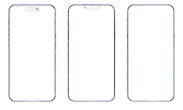
WHY WE SHOULD JOIN INKLINK ?
🌍Express Freely
🚀Share to grow
🎯Personalised Dashboard
Write about anything and everything - Your voice matters
Connect with readers who love your vibe and build a fanbase
Track your post, Stats, followers all in one place
🧠learn & Explore
📱Mobile Friendly
Explore topics like Tech & AI, Lifestyle, Art or many more...
Write and read blogs on any device anytime, anywhere

Slide 18
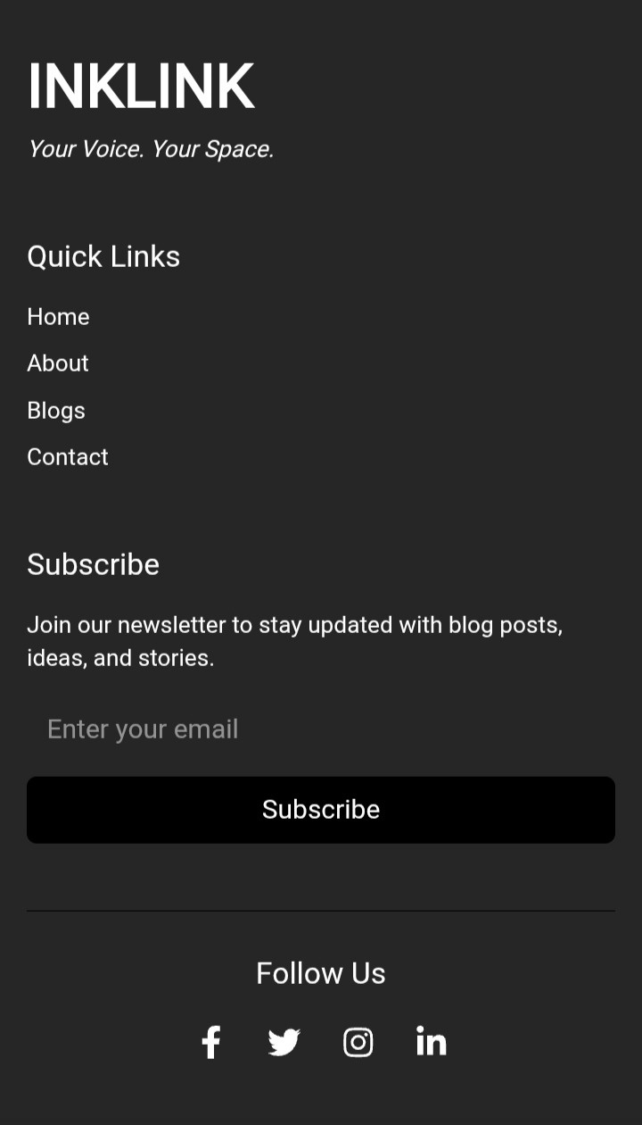
Footer Section
Elements
Home
About
Contact
Blog
Social Media
Copyright

Slide 19
Future Scope
Future Scope: The project provides a strong foundation for a personal blogging platform, and future work could focus on adding more features for authenticated users, such as the ability to create and edit their own blog posts, and to fully utilize the personalized dashboard.
Deployed web:-https://inklink-alsx.vercel.app/

Slide 20
THANKYOU

